Slide 1






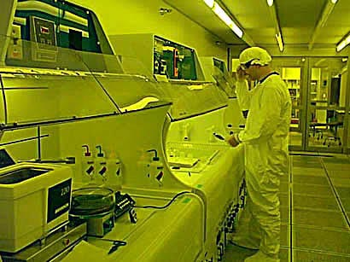

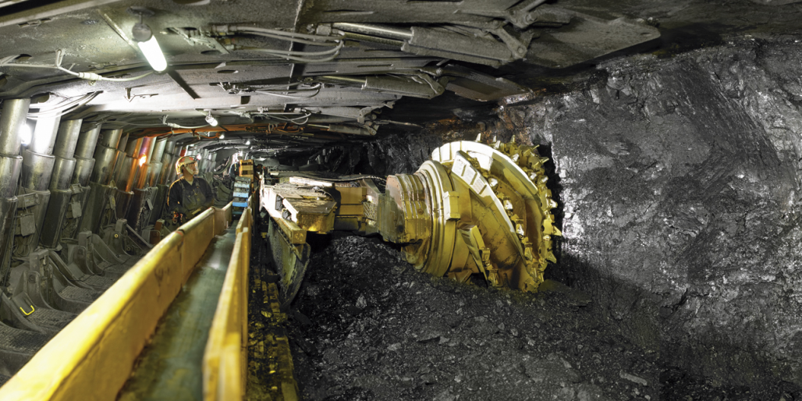
SHIFTWORK SOLUTIONS
(415) 585-8585
www.shift-work.com

Slide 2
Finding the Best Schedules
Future
Business Requirements
Alertness Safety
Employee Participation
Business Requirements
Employee Participation
Alertness Safety
Plans
Future Plans

Slide 3
Project set up, leadership kickoff, operations data collection, and department interviews
Operations Analysis
Review and decide on the best schedule concepts
Employee Schedule Survey, including on-shift Q&A sessions
Review Shift Schedule Survey results and identify best options
Finalize and approve schedule options
Employee Schedule Preference Survey
Employee Q&A sessions
Finalize the schedule(s)

Slide 4
Project set up, leadership kickoff, operations data collection, and department interviews
Operations Analysis
Review and decide on the best schedule concepts
Employee Kickoff: Bulletin with timeline + introductory videos or kickoff meeting
Employee Schedule Survey, including on-shift Q&A sessions
Review Shift Schedule Survey results and identify best options
Survey Summary Report + Survey Summary Video
Finalize and approve schedule options
Schedule Options Documentation + Schedule Options Explanation Meeting
Employee Schedule Preference Survey
Employee Q&A sessions
Finalize the schedule(s)

